Slide 1
Obstacle Avoiding Robot
CHETHAN
4nm19me025@nmamit.in

Slide 2
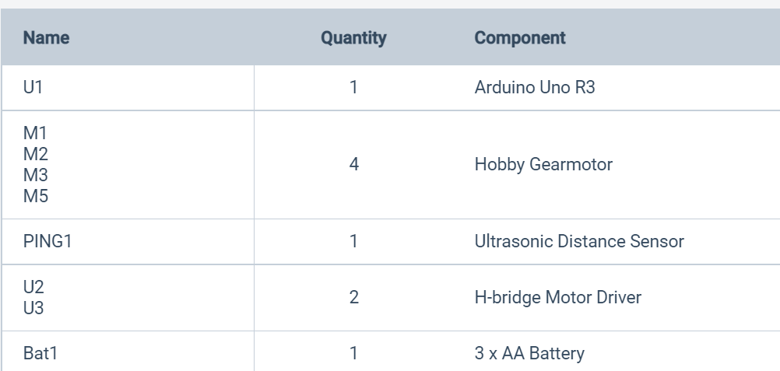
Components Involved

Slide 3
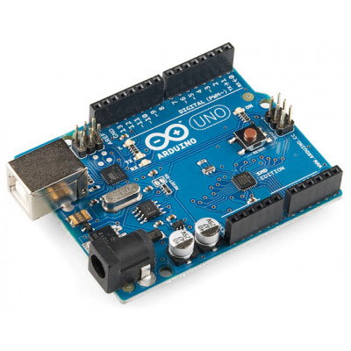
Arduino
The microcontroller used in this project is an Arduino Uno
Arduino is an opensource platform.
The Arduino boards are easily programmed on the Arduino Software (IDE). Arduino Uno is based on the microcontroller ATmega328P which has a flash memory of 32 kB
It has 14 digital input/output pins and six of these can be used as PWM outputs

Slide 4
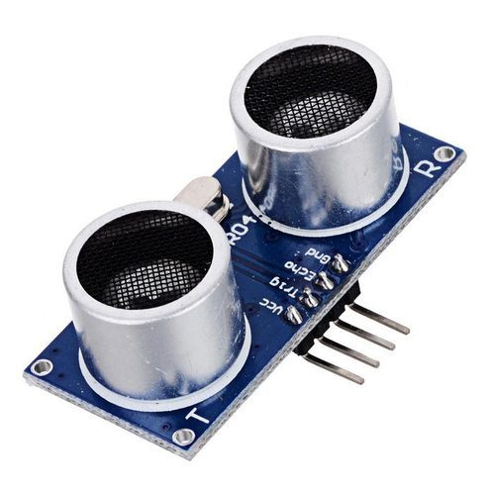

Ultrasonic sensor
Ultrasonic sensors measure distance by transmitting pulses of ultrasonic sound-waves which propagates through the air
Reflected wave is received by the sensor when there is an object in front of them.
If there is an object in front of the sensor, the sound-waves reflects and returns to the receiver
One problem with them is that if the object in front of the sensor is tilted relative to the sensor’s transceiver, only such a small amount of the sound-wave will be reflected back to the sensor that the object won’t be detected

Slide 5
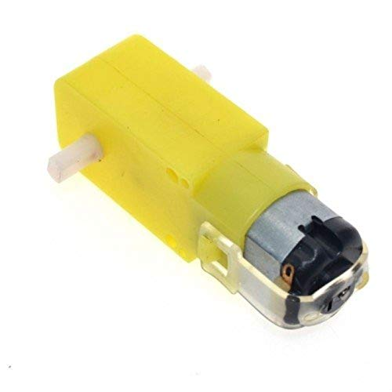
DC motor with gear drive
DC motors are those class of rotary electrical motors that converts direct current (DC) electrical energy into mechanical energy
The most common types rely on the forces produced by magnetic fields. Nearly all types of DC motors have some internal mechanism, either electromechanical or electronic, to periodically change the direction of current in part of the motor
DC motors were the first form of motor widely used, as they could be powered from existing direct-current lighting power distribution systems
A DC motor's speed can be controlled over a wide range

Slide 6
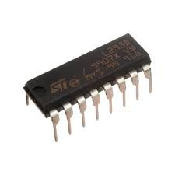
Motor Driver (L293D)
The L293D is quadruple high-current half-H drivers
It is designed to provide bidirectional drive currents of up to 600-mA at voltages from 4.5 V to 36 V
Both devices are designed to drive inductive loads such as relays, solenoids, dc and bipolar stepping motors, as well as other high-current/high-voltage loads in positive-supply applications
All inputs are TTL compatible. Each output is a complete totem-pole drive circuit, with a Darlington transistor sink and a pseudo- Darlington source
Drivers are enabled in pairs, with drivers 1 and 2 enabled by 1,2EN and drivers 3 and 4 enabled by 3,4EN

Slide 7
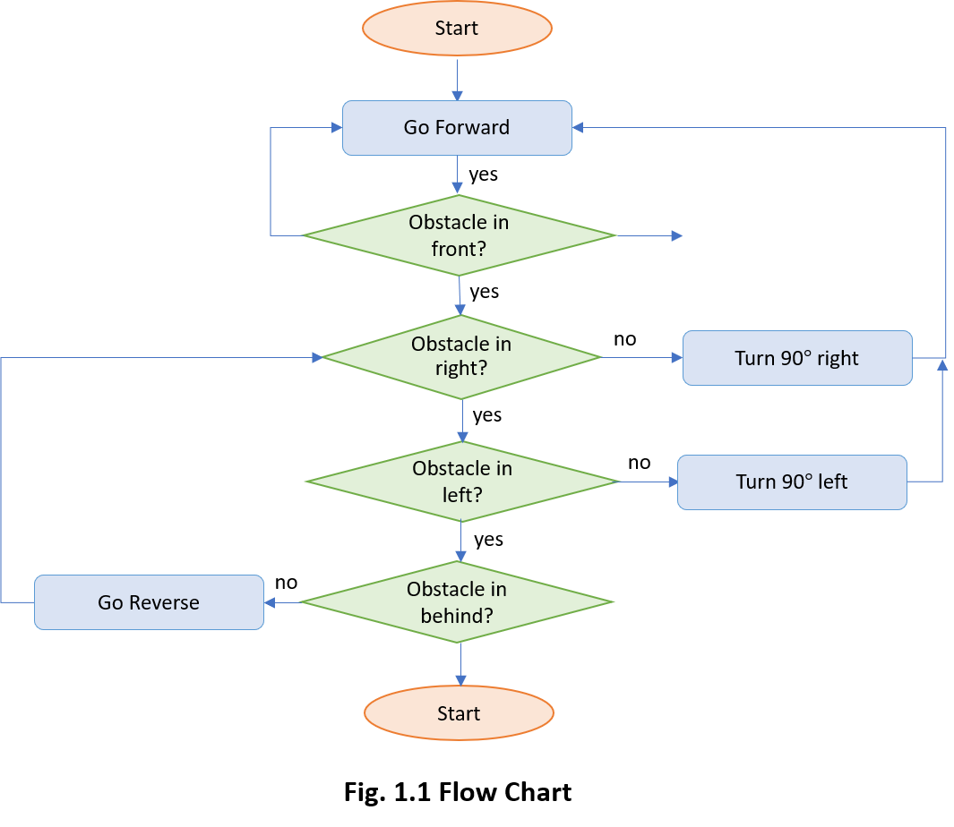
Code and algorithm

Slide 8
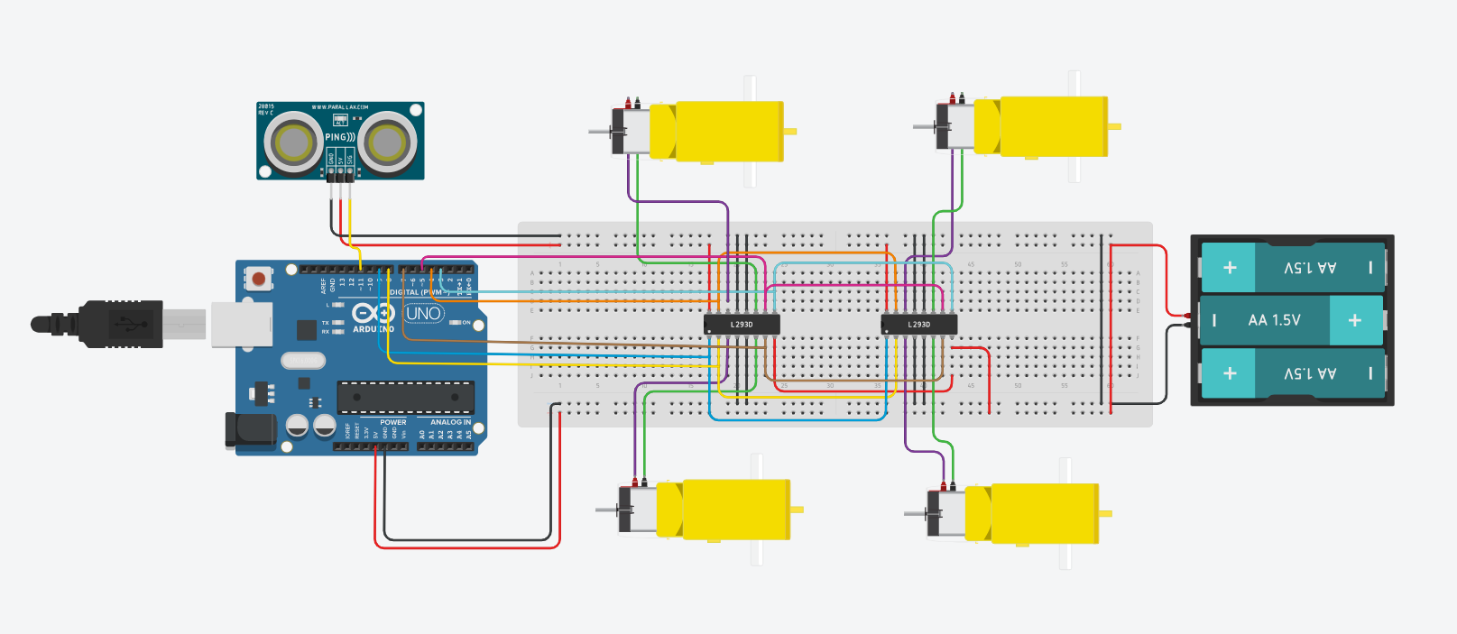
Circuit

Slide 9
THANK YOU

